Slide 1
Action!
www.katatogrow.com

Slide 2
THREE THINGS TO DO NEXT
Choose a Team Name
Select a Timekeeper
→ Each gets a stopwatch
Select a Data Recorder
→ 'Baseline Rounds' form
www.katatogrow.com
Notes:
The teacher can also assign the roles
Give each timekeeper a stopwatch, or have them set their smartphone to the stopwatch function.
Ask the data recorders to raise their hands.
Ask the timers to raise their hands.
Go around the room and ask each team what name it selected.

Slide 3
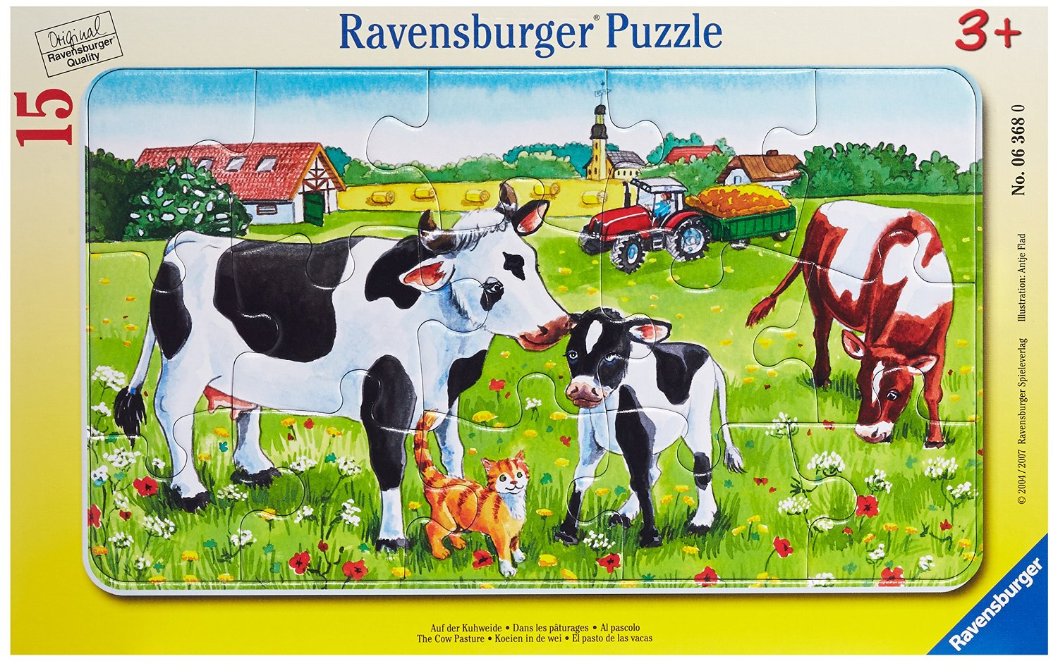
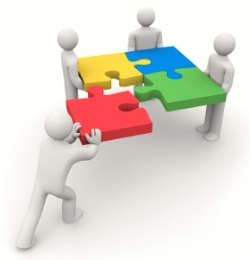
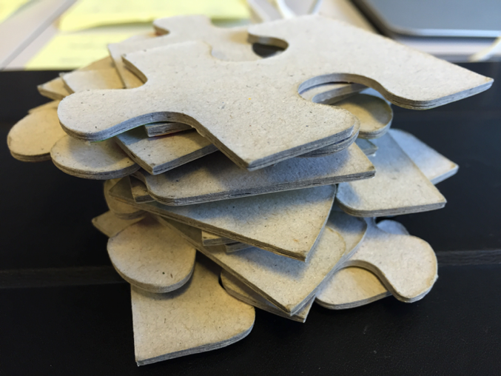
Take the puzzle and study the picture.
Remove the puzzle pieces from the frame.
Put the frame back aside.
Do the entire exercise without the
puzzle frame
Put the Frame Aside
www.katatogrow.com
Notes:
(Read the slide)
Each team table should have a bag with:
One puzzle / Forms 1 & 2 / A red pen & a pencil / One reflection card per person
Have each data recorder write their team's name on the 'Baseline Rounds' form.

Slide 4
Step 1:
UNDERSTAND THE CHALLENGE
1
Get the Direction or
Challenge
Establish your Next
Target
Condition
Conduct experiments
to get there
Grasp the Current
Condition
Notes:
(This slide has an animation)
"The challenge for building this puzzle is to do it in 18 seconds. That's the long-term goal."
Stick a large Post-It arrow with '18 Seconds' on Poster 2 under the 'Challenge' circle.
"A challenge is often given to you from above, like an overall goal at work or for a project. It's often not something we get to choose."

Slide 5
Vision
Be the fastest puzzle assemblers, no matter how many pieces there are in the puzzle.
Assemble the 15-piece puzzle in 15 seconds by round 50.
Challenge

Slide 6
Step 1:
UNDERSTAND THE CHALLENGE
1
Get the Direction or
Challenge
Establish your Next
Target
Condition
15
SECONDS
Conduct experiments
to get there
Grasp the Current
Condition
www.katatogrow.com
Notes:
(This slide has an animation)
"The challenge for building this puzzle is to do it in 18 seconds. That's the long-term goal."
Stick a large Post-It arrow with '18 Seconds' on Poster 2 under the 'Challenge' circle.
"A challenge is often given to you from above, like an overall goal at work or for a project. It's often not something we get to choose."

Slide 7
Step 2:
GRASP THE CURRENT CONDITION
Get the Direction or
Challenge
Establish your Next
Target
Condition
2
Conduct experiments
to get there
Grasp the Current
Condition
www.katatogrow.com
Notes:
Ask each team what their last baseline time was.
DO NOT USE AVERAGES
"OK, this is your team's starting point."

Slide 8
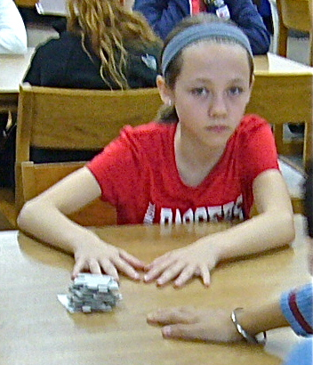
TODAY'S GROUND RULES
(1) "START Position" =
- Puzzle pieces shuffled in random order
- Pieces face down in one stack
- Hands flat on the table
(2) All Teams Start Together
a. Instructor calls "START"
b. Build the puzzle
c. Note the elapsed time on your form
(3) Don't Write on the Puzzle or Tape anything
www.katatogrow.com
Notes:
Read through the GROUND RULES.
Run two (2) baseline rounds.
Ask students to raise their hand when their team is done building.
Give the teams ~60 seconds between the two rounds, to discuss.

Slide 9
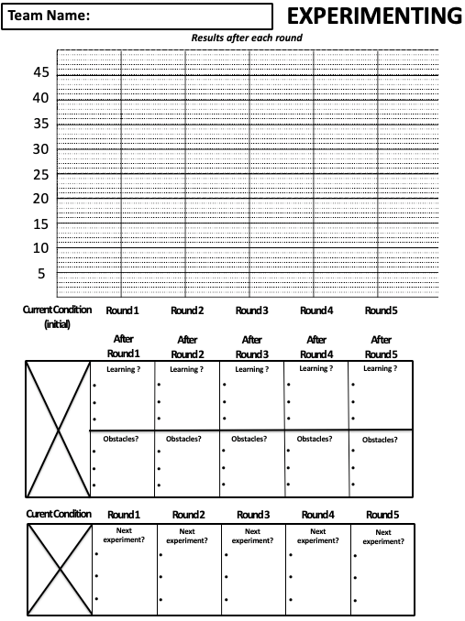
Note your Current Condition (initial)
Current Condition
32s
X
Notes:
Explain how to use the 'EXPERIMENTING' form:
Before each experimenting round each team should jot down the ideas they would like to test in that round.
After the experiment the team should write the elapsed time, the learning lessons and the obstacles encountered.

Slide 10
Step 3:
ESTABLISH YOUR NEXT
TARGET CONDITION
3
Get the Direction or
Challenge
Establish your Next
Target
Condition
What puzzle build time does your team want to reach in Round 5?
Conduct experiments
to get there
Grasp the Current
Condition
www.katatogrow.com
Notes:
(This slide has an animation)
Have the teams discuss and decide the following:
"What puzzle build time does your team want to reach in this class period?"
Give the teams 90 seconds to discuss (timer starts on the next slide)

Slide 11
Step 3:
ESTABLISH YOUR NEXT
TARGET CONDITION
3
Get the Direction or
Challenge
Establish your Next
Target
Condition
Conduct experiments
to get there
Grasp the Current
Condition
www.katatogrow.com
Notes:
(This slide has an animation)
Have the teams discuss and decide the following:
"What puzzle build time does your team want to reach in this class period?"
Give the teams 90 seconds to discuss (timer starts on the next slide)

Slide 12
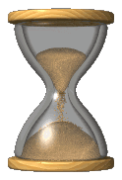
Take a few seconds to establish your next Target Condition (Round 5)

Slide 13
Note your next Target Condition
32s
X
Example of a Target
Condition
TC
21s

Slide 14
What will be your next step (first experiment)?
32s
X

Slide 15
Take a few seconds to determine your next step…

Slide 16
Step 4:
CONDUCT EXPERIMENTS TO GET THERE
Get the Direction or
Challenge
Establish your Next
Target
Condition
4
Conduct experiments
to get there
Grasp the Current
Condition
www.katatogrow.com
Notes:
"Now you can do some experiments toward your Target Condition."

Slide 17
During each round
3:00
Assemble the puzzle
1) Note the time (Current Condition now)
2) Note what you learned
3) Note the obstacles met
4) Note what will be your next step (experiment)
You assemble the puzzle only one time per round

Slide 18
Update your Experimenting Form after each round
Note the time
(Current Condition now)
44s
X
32s
X
2) Note what you learned
3) Note the obstacles you met
4) Note what will be you next step (experiment)

Slide 19
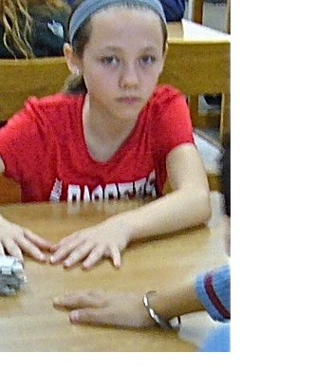
Get ready for Round 1 ?
Time keepers are you ready ?
www.katatogrow.com

Slide 20
Round 1
ROUND OVER
Assemble the puzzle
1) Note the time (Current Condition now)
2) Note what you learned
3) Note the obstacles met
4) Note what will be your next step (experiment)

Slide 21
Get ready for Round 2 ?
Time keepers are you ready ?
www.katatogrow.com

Slide 22
Round 2
ROUND OVER
Assemble the puzzle
1) Note the time (Current Condition now)
2) Note what you learned
3) Note the obstacles met
4) Note what will be your next step (experiment)

Slide 23
REFLECTING ON EACH EXPERIMENT
After each round we'll ask one team
this set of Reflection Questions
www.katatogrow.com
Notes:
(Read the slide and the card)
After Round 2 of experimenting the instructor will hold the card and ask one team all the Reflection Questions. The instructor can call on a team or ask for a team to volunteer.
After each subsequent round (Experimenting Round 2+) the instructor has a person from one team ask all the Reflection Questions of another team.

Slide 24
Get ready for Round 3 ?
Time keepers are you ready ?
www.katatogrow.com

Slide 25
Round 3
ROUND OVER
Assemble the puzzle
1) Note the time (Current Condition now)
2) Note what you learned
3) Note the obstacles met
4) Note what will be your next step (experiment)

Slide 26
REFLECTING ON EACH EXPERIMENT
After each round we'll ask one team
this set of Reflection Questions
www.katatogrow.com

Slide 27
Get ready for Round 4 ?
Time keepers are you ready ?
www.katatogrow.com

Slide 28
Round 4
ROUND OVER
Assemble the puzzle
1) Note the time (Current Condition now)
2) Note what you learned
3) Note the obstacles met
4) Note what will be your next step (experiment)

Slide 29
REFLECTING ON EACH EXPERIMENT
After each round we'll ask one team
this set of Reflection Questions
www.katatogrow.com

Slide 30
Get ready for Round 5 ?
Time keepers are you ready ?
www.katatogrow.com

Slide 31
Round 5
ROUND OVER
Assemble the puzzle
1) Note the time (Current Condition now)
2) Note what you learned
3) Note the obstacles met
4) Note what will be your next step (experiment)

Slide 32
REFLECTING ON EACH EXPERIMENT
After each round we'll ask one team
this set of Reflection Questions
www.katatogrow.com

Slide 33
Lessons LEARNED

Slide 36
